Slide 1
ACADEMIC PROJECT PRESENTATION | 2026–2027
Student Performance &
Attendance Analysis System
A web-based educational analytics & monitoring solution
Department of Computer Science & Engineering
SUBMITTED BY
SUPERVISION & DEPARTMENT
INSTITUTION
Subhamita Mitra
Dept. of Computational Sciences
Brainware University
Reg. No. : 26102000129
Supervisor: Mr. Rahul Kumar Ghosh
Master of Computer Applications
Roll No. : 26102410009
Academic Session 2026–2027
Code: BWU/MCA/26/011
MARKS
ATTENDANCE
INSIGHTS
STUDENT PERFORMANCE & ATTENDANCE ANALYSIS SYSTEM • 2026–2027
01

Slide 2
01 | OVERVIEW
From manual record-keeping to actionable academic insight
A compact workflow for maintaining student records, evaluating results and identifying attendance risk.
THE CHALLENGE
THE SOLUTION
THE VALUE
Manual registers slow down evaluation; arithmetic errors can affect grades; low attendance can remain unnoticed.
A Flask web application centralizes student entry, validation, grading, search, sorting and analytics.
Consistent calculations, a 75% attendance warning threshold and on-demand visual reports.
01
Capture
→
02
Validate
→
03
Evaluate
→
04
Explore
STUDENT PERFORMANCE & ATTENDANCE ANALYSIS SYSTEM • 2026–2027
02

Slide 3
02 | TECHNOLOGY
A lightweight Python analytics stack
The presentation describes a self-contained web solution backed by flat-file storage.
WEB APPLICATION
ANALYTICS ENGINE
PERSISTENCE LAYER
Python 3 and Flask provide the route/controller layer. Jinja2 renders the dashboard and dynamic page content. Server-side validation protects submitted records.
Pandas performs DataFrame aggregation for minimum, maximum and mean. NumPy supports numerical operations. Matplotlib uses the Agg backend to generate PNG charts.
students.csv stores structured records. students.txt provides a human-readable audit-style log. The design avoids requiring a separate RDBMS server.
CORE CAPABILITIES
✓ CRUD operations
✓ Input validation
✓ Grade calculation
✓ Search & sort
✓ Attendance filtering
✓ Statistical charts
STUDENT PERFORMANCE & ATTENDANCE ANALYSIS SYSTEM • 2026–2027
03

Slide 4
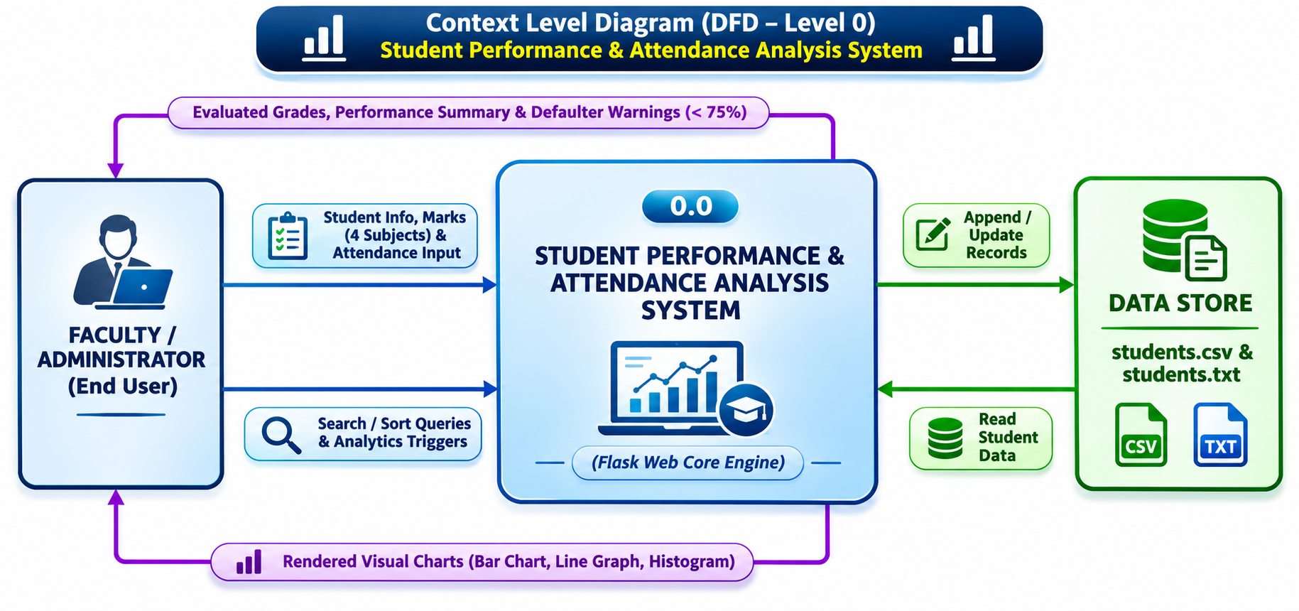
03 | SYSTEM DESIGN
Context architecture
Section 5.1 • System boundary, external actor, central process and data exchanges
KEY DESIGN POINTS
01
Faculty/Admin supplies student details, four subject marks and attendance.
02
Flask core coordinates validation, grade calculation and request routing.
03
CSV and TXT files support record updates and retrieval.
04
Outputs include grade rosters, attendance warnings and charts.
STUDENT PERFORMANCE & ATTENDANCE ANALYSIS SYSTEM • 2026–2027
04

Slide 5
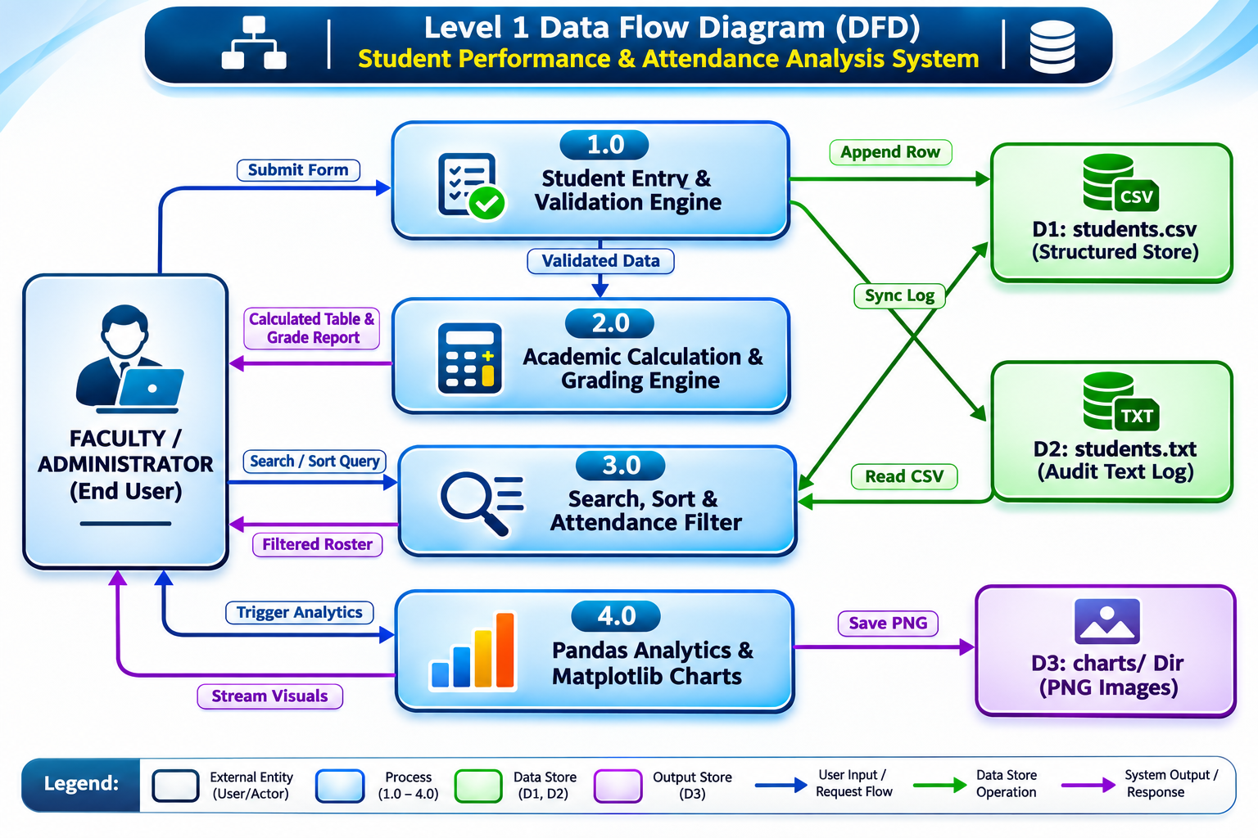
03 | SYSTEM DESIGN
Core subsystem decomposition
Section 5.2 • Four logical processes organize the application responsibilities
KEY DESIGN POINTS
01
1.0 Entry: validate input and check roll-number conflicts.
02
2.0 Grading: calculate totals, averages, percentages and grades.
03
3.0 Query: filter attendance and perform search/sort operations.
04
4.0 Analytics: aggregate statistics and generate Matplotlib charts.
STUDENT PERFORMANCE & ATTENDANCE ANALYSIS SYSTEM • 2026–2027
05

Slide 6
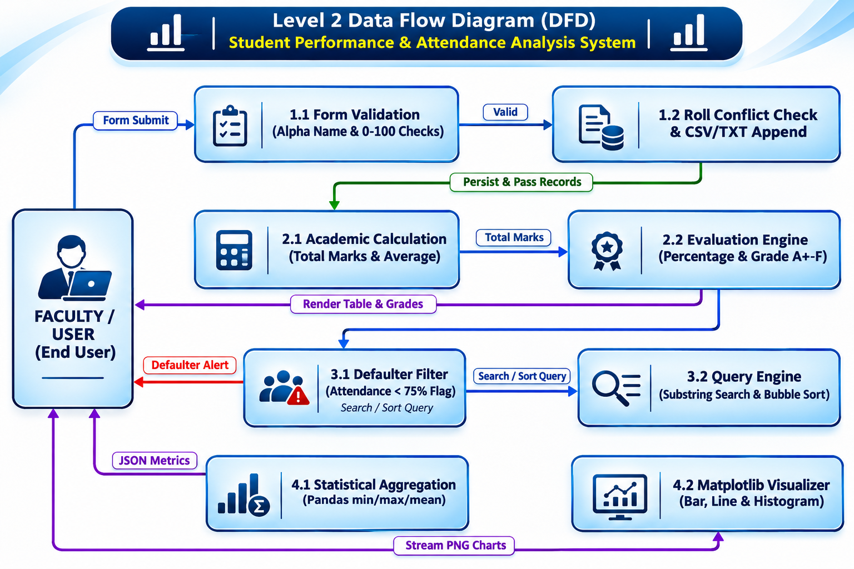
03 | SYSTEM DESIGN
Detailed process flow
Section 5.3 • Sub-processes connect validation, grading, filtering and visualization
KEY DESIGN POINTS
01
1.1–1.2: validate names and mark ranges; check roll conflicts and persist records.
02
2.1–2.2: calculate total/average, then evaluate percentage and letter grade.
03
3.1–3.2: identify attendance below 75% and execute substring search/sort.
04
4.1–4.2: calculate Pandas statistics and generate chart images.
STUDENT PERFORMANCE & ATTENDANCE ANALYSIS SYSTEM • 2026–2027
06

Slide 7
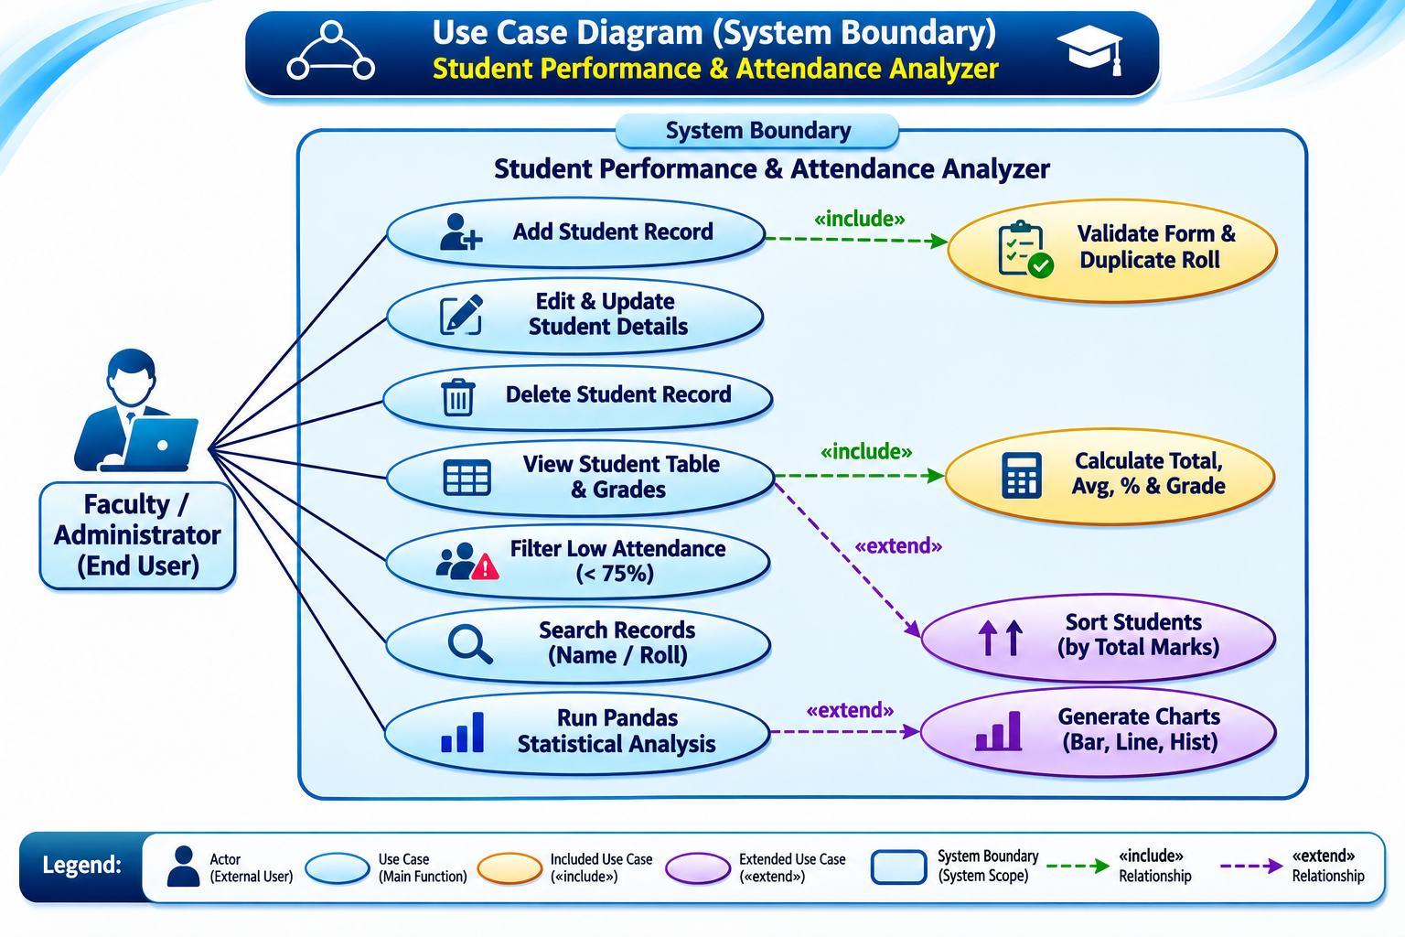
03 | SYSTEM DESIGN
Actor roles and functional scope
Section 5.4 • Faculty/Administrator is the primary system actor
KEY DESIGN POINTS
01
Manage student records: add, edit, update, delete and view.
02
Filter students whose attendance is below 75%.
03
Search by student name or roll number; sort by total marks.
04
Mandatory validation/calculation are included; sorting and charts are optional extensions.
STUDENT PERFORMANCE & ATTENDANCE ANALYSIS SYSTEM • 2026–2027
07

Slide 8
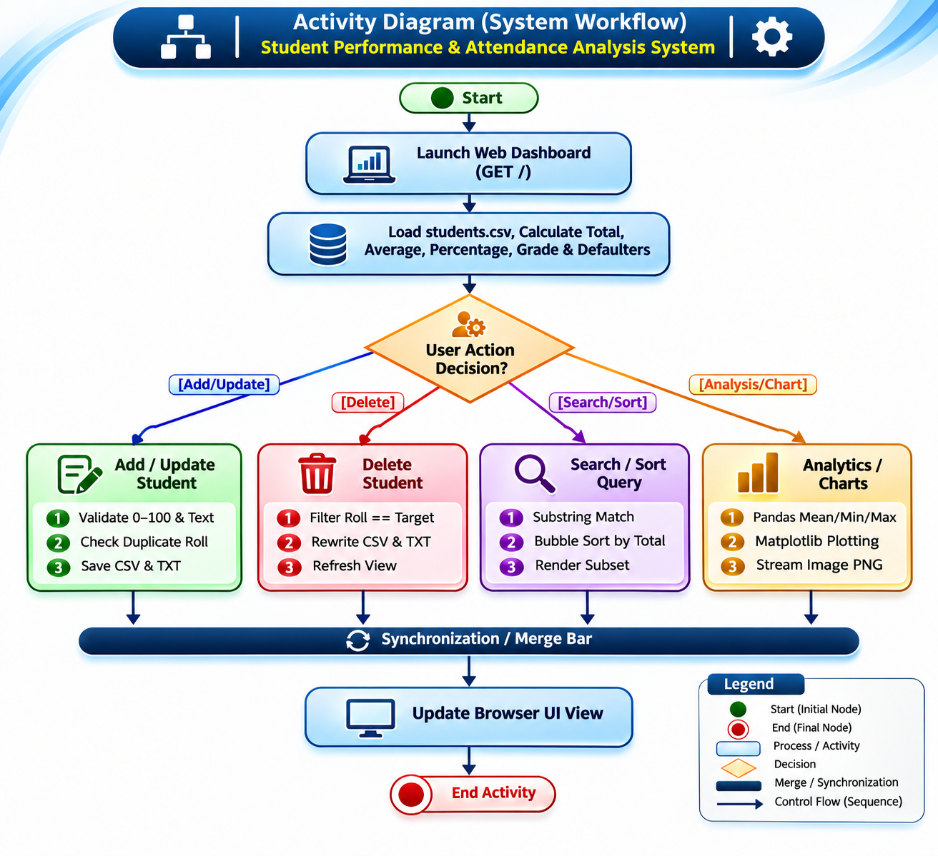
04 | WORKFLOW
Application activity lifecycle
Section 5.5 • A unified dashboard routes each user action through a controlled workflow
KEY DESIGN POINTS
01
Initialize folders, verify the CSV header and prepare student metrics.
02
Render the dashboard with student table and calculated values.
03
Route Add/Edit, Delete, Search/Sort and Analytics/Chart operations.
04
Reject invalid input with an alert; persist valid changes and refresh the UI.
STUDENT PERFORMANCE & ATTENDANCE ANALYSIS SYSTEM • 2026–2027
08

Slide 9
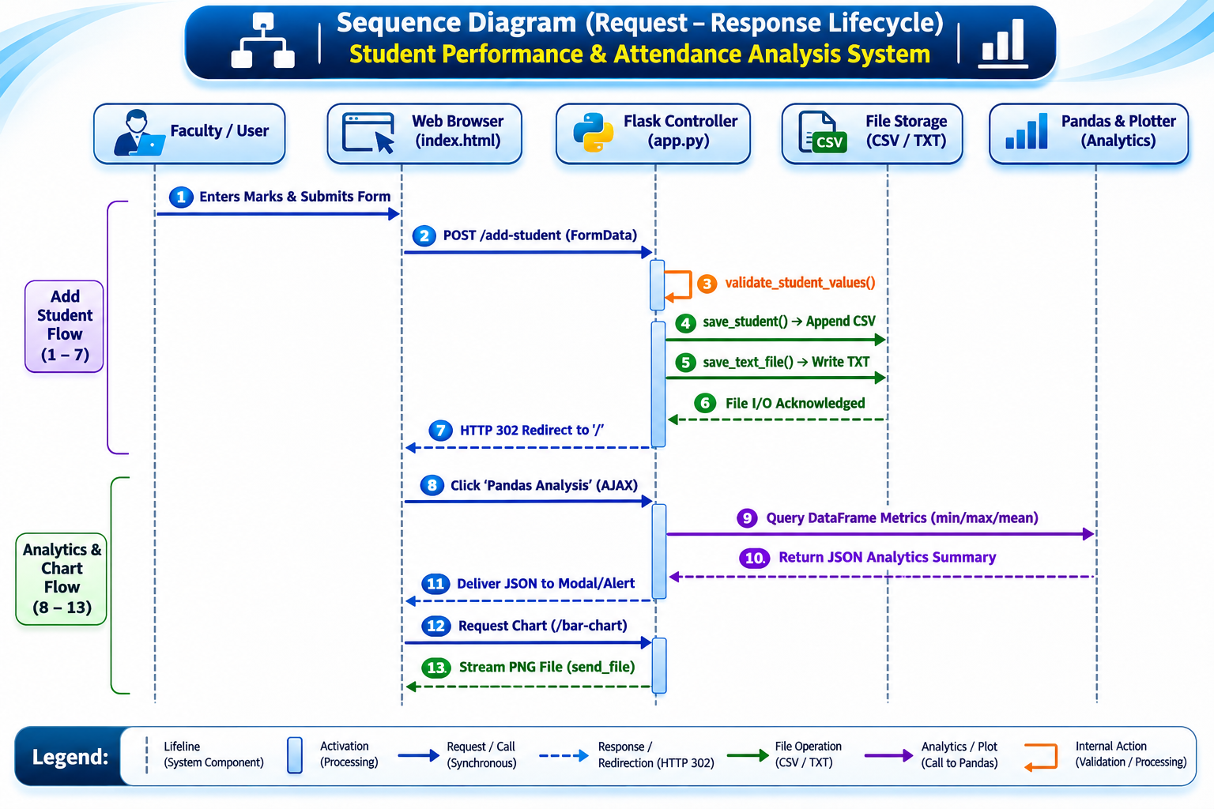
04 | WORKFLOW
Request–response sequence
Section 5.6 • Browser, Flask controller, file storage and analytics components
KEY DESIGN POINTS
01
The browser submits FormData to the Flask add-student endpoint.
02
The controller validates input and updates CSV/TXT storage.
03
A redirect reloads the dashboard with current records.
04
AJAX requests retrieve a JSON analytics summary or request a PNG chart.
STUDENT PERFORMANCE & ATTENDANCE ANALYSIS SYSTEM • 2026–2027
09

Slide 10
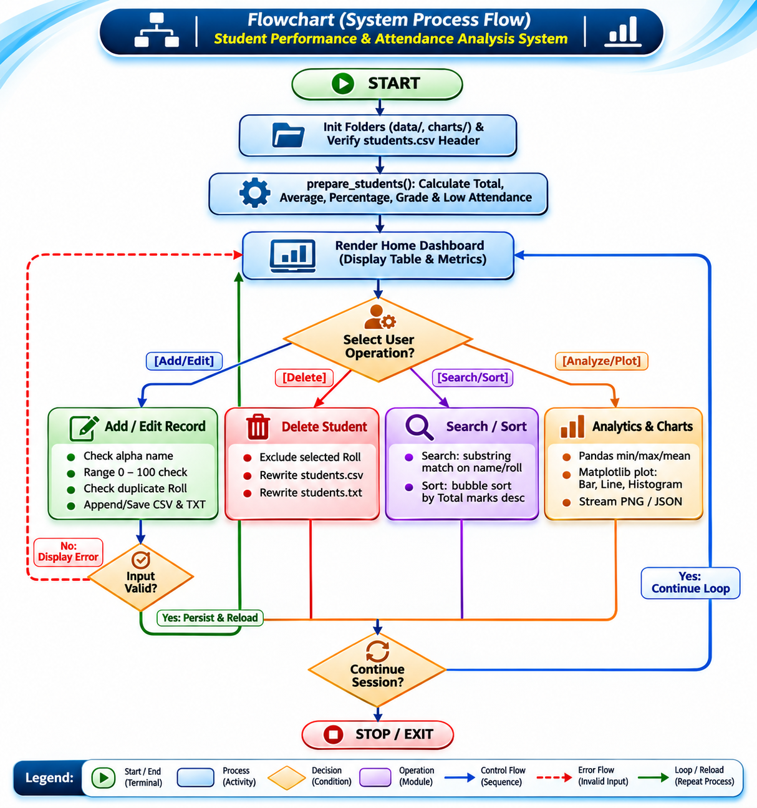
04 | WORKFLOW
Algorithmic execution logic
Section 5.7 • Initialization, data preparation, operation routing and session control
KEY DESIGN POINTS
01
Ensure data/ and charts/ directories exist and verify the CSV structure.
02
Prepare records by calculating totals, percentages, grades and attendance flags.
03
Dispatch the selected operation to its dedicated processing path.
04
Return to the dashboard while the application session remains active.
STUDENT PERFORMANCE & ATTENDANCE ANALYSIS SYSTEM • 2026–2027
10

Slide 11
05 | RESULTS
Sample cohort: performance and attendance at a glance
Six sample records shown in the supplied presentation • maximum total = 400 marks
297.83
74.46%
72.50%
3 / 6
Class mean / 400
Mean percentage
Mean attendance
Attendance below 75%
Roll | Student | Total / 400 | Percentage | Grade | Attendance
011 | Subhamita Mitra | 317 | 79.25% | B | 82%
012 | Trisha Biswas | 364 | 91.00% | A+ | 89%
013 | Dipanweeta Baidya | 241 | 60.25% | C | 60%
014 | Suhana Chakrabarty | 302 | 75.50% | B | 80%
015 | Anushka Saha | 243 | 60.75% | C | 74%
016 | Rim Karmakar | 320 | 80.00% | A | 50%
Top achiever: Trisha Biswas (364 marks, 91.00%, Grade A+) • Attendance threshold: <75%
STUDENT PERFORMANCE & ATTENDANCE ANALYSIS SYSTEM • 2026–2027
11

Slide 12
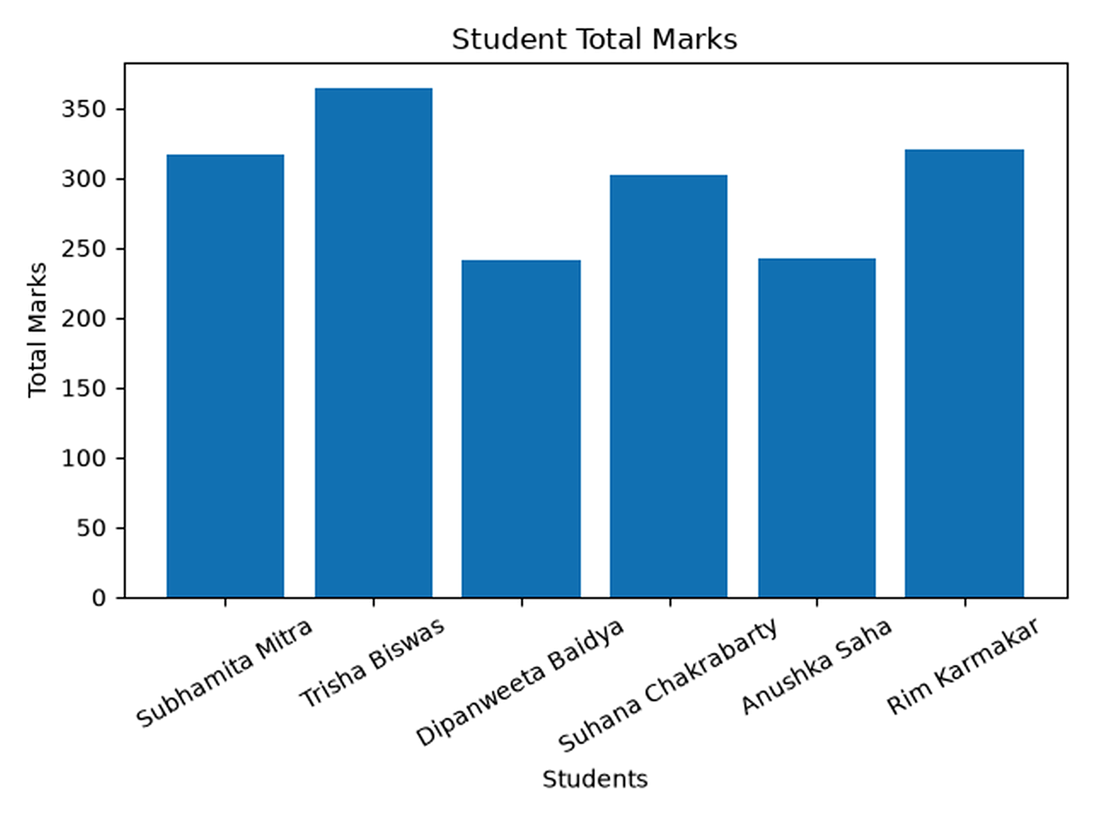
05 | RESULTS
Comparative total marks
Bar chart from the supplied project presentation • student totals are out of 400
LEADING SCORE
Trisha Biswas — 364 marks
NEXT HIGH PERFORMERS
Rim Karmakar — 320
Subhamita Mitra — 317
INTERPRETATION
The chart makes differences in cumulative marks immediately visible and helps identify students who may need additional academic support.
STUDENT PERFORMANCE & ATTENDANCE ANALYSIS SYSTEM • 2026–2027
12

Slide 13
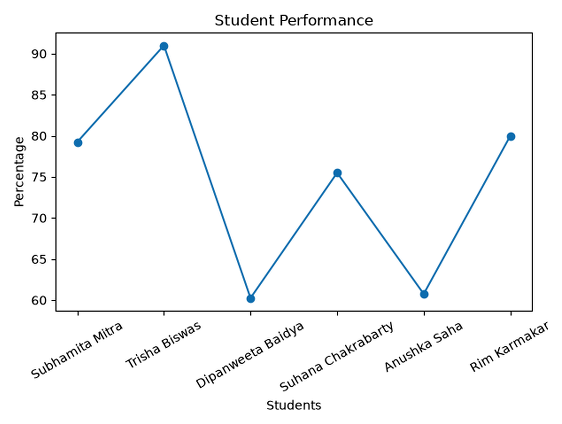
05 | RESULTS
Student percentage performance
Line graph from the supplied project presentation • percentages are based on four subjects
PEAK
Trisha Biswas — 91.00%
LOWEST
Dipanweeta Baidya — 60.25%
INTERPRETATION
The variation highlights differences across the cohort and can guide faculty review and targeted academic support.
STUDENT PERFORMANCE & ATTENDANCE ANALYSIS SYSTEM • 2026–2027
13

Slide 14
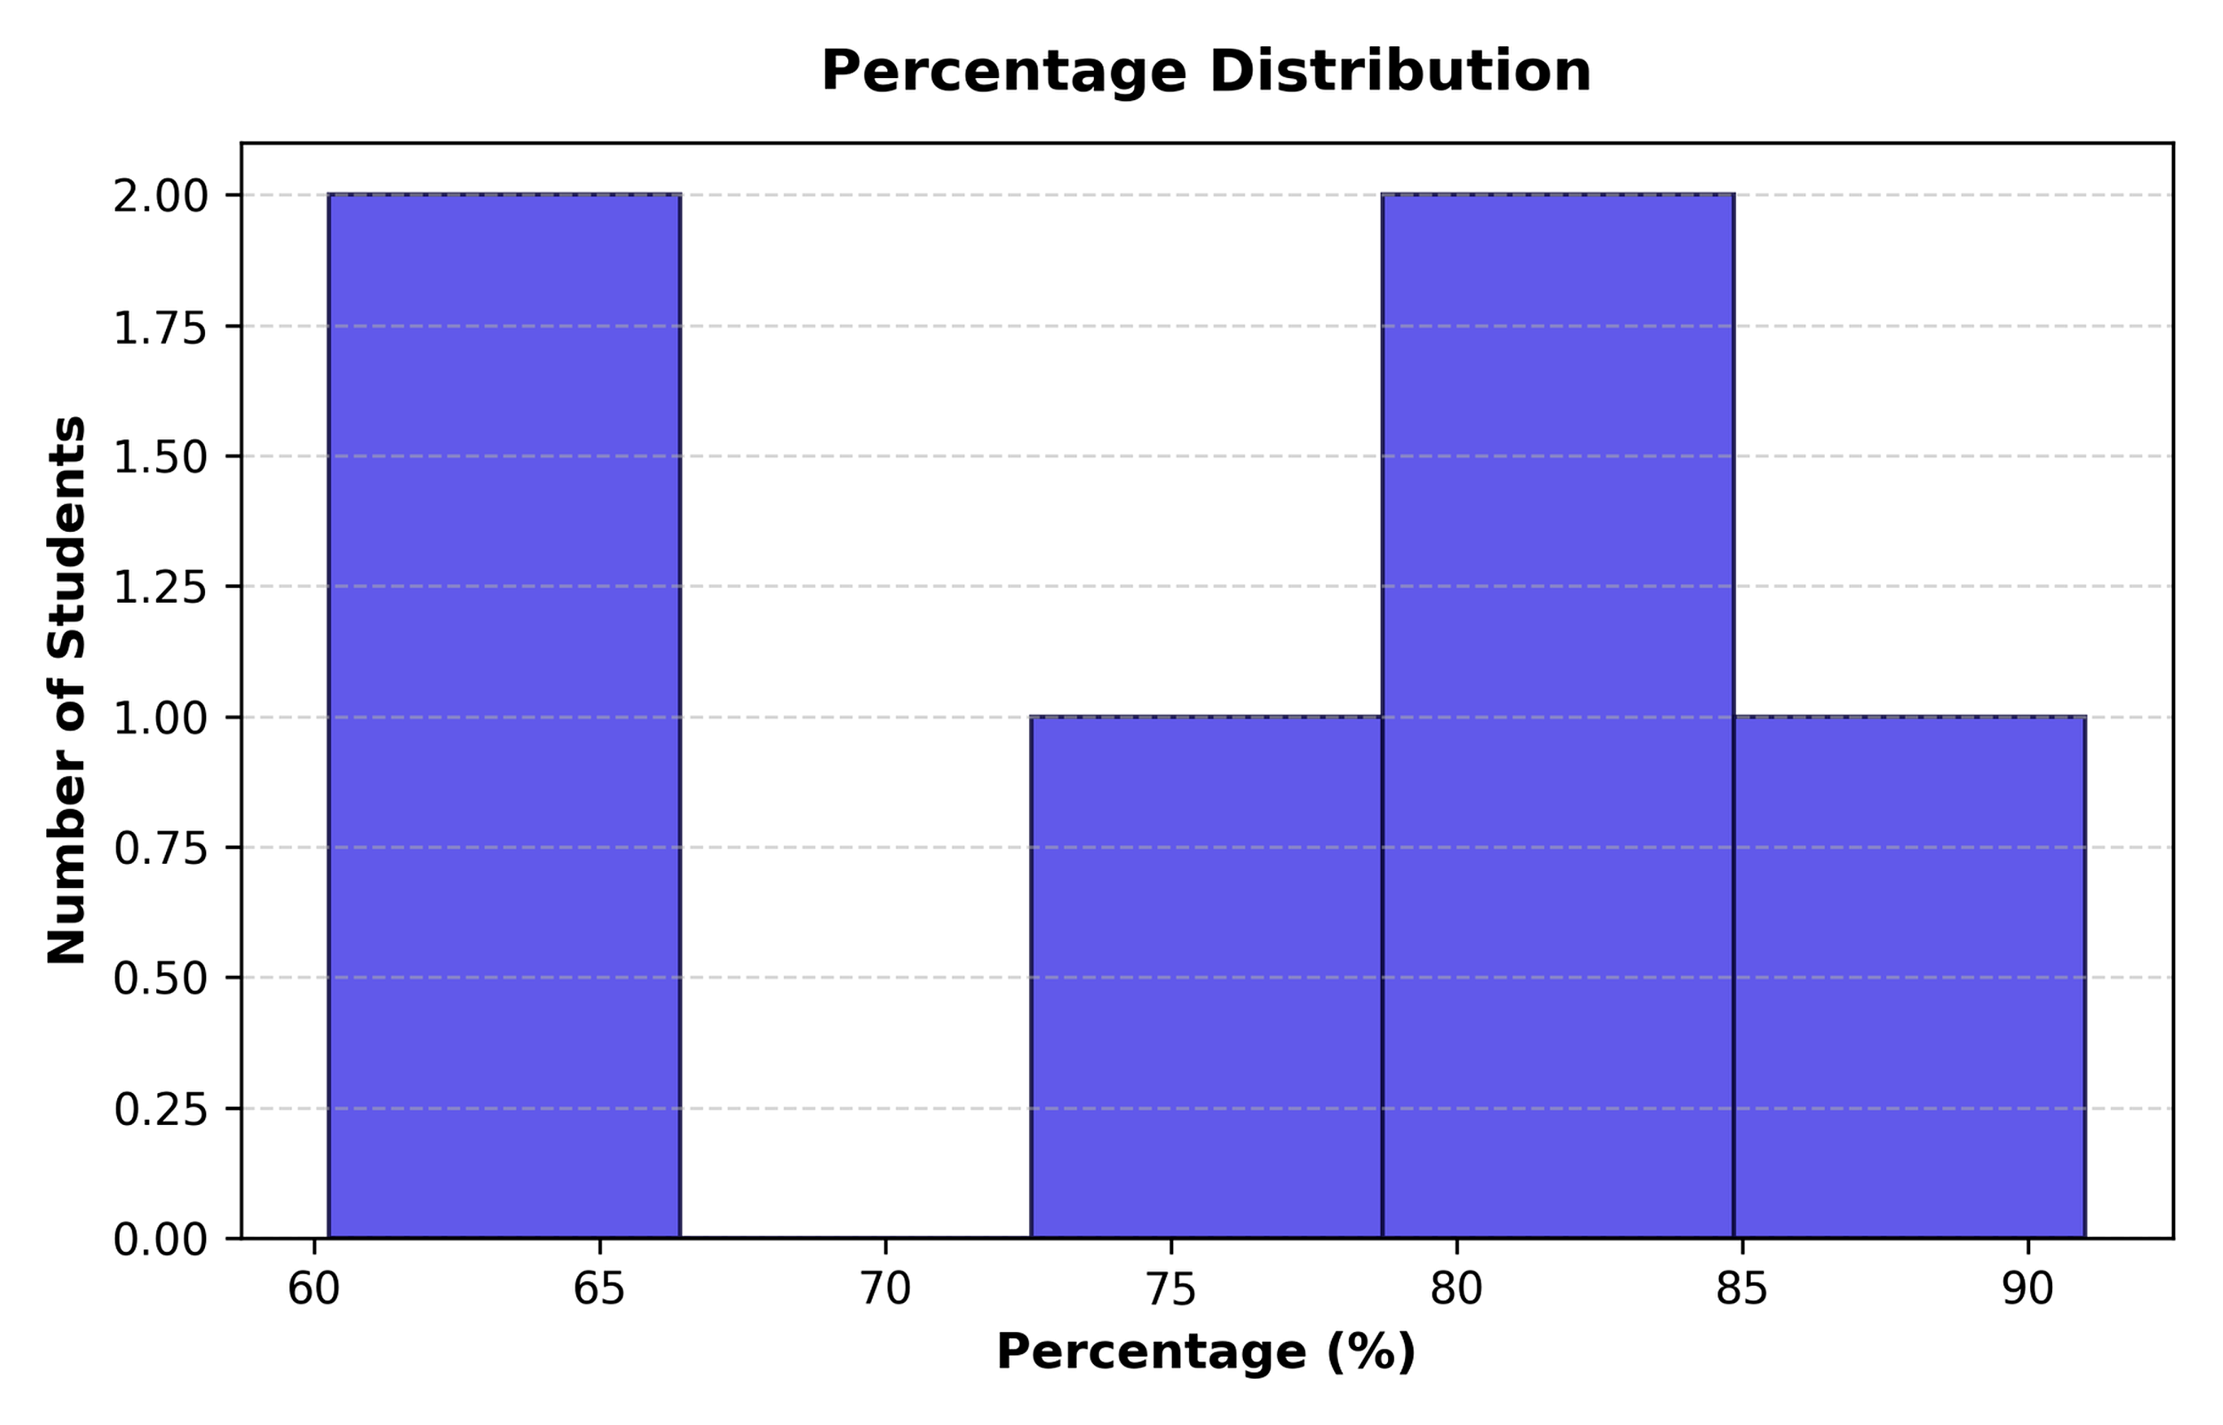
06 | INSIGHTS & ROADMAP
Score distribution and planned enhancements
The supplied presentation identifies distribution patterns and future expansion opportunities.
OBSERVATIONS
The sample histogram shows concentrations around 60–65% and 79–85%, with one result in the 90–95% band.
FUTURE ROADMAP
DATABASE
Planned migration to PostgreSQL with SQLAlchemy ORM support.
NOTIFICATIONS
Planned SMS and email alerts for attendance warnings.
STUDENT PERFORMANCE & ATTENDANCE ANALYSIS SYSTEM • 2026–2027
14

Slide 15
07 | PROJECT CONCLUSION
Clearer academic records.
More actionable insight.
The system brings student data entry, grading, attendance monitoring and visual analytics into one lightweight web workflow.
ACCURACY
VISIBILITY
INSIGHT
Consistent validation and automated grade calculations.
Attendance threshold flags and cohort-level summaries.
Charts that make performance patterns easier to review.
Thank You | Questions & Discussion Welcome
Department of Computer Science & Engineering • Academic Session 2026–2027
STUDENT PERFORMANCE & ATTENDANCE ANALYSIS SYSTEM • 2026–2027
15

